Slide 1
Perception
Perception is a process by which people analyze, retrieve and react to any kind of information from the environment. For example, some people feel happy about earning money while others feel happy about spending money

Slide 2
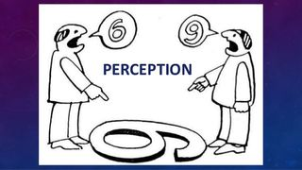

Slide 3
Factors affecting Perception
Intensity The more intense something is, the more likely it is that it will be perceived. For example, people are more likely to perceive a loud noise rather than a quiet background noise
Changes
When driving in a car, there are constant changes in visual stimuli. So, what we see/perceive constantly changes.

Slide 4
Magnitude
The larger the size of an object, the more likely it is to be seen/perceived.
Repetition
Repetition increases our sensitivity to the stimuli. This means that we become more aware of stimuli because it has been perceived frequently.

Slide 5
Psychological factors affecting perception
Motivation
-We are more likely to perceive and see objects or aspects of objects that are of interest to us.
Example
Going to the shop when hungry can lead you to buy more food than you normally would.

Slide 6
Emotions
Emotions such as stress and anxiety can influence how much and what we perceive
Sad or happy feelings can affect how stimuli are interpreted; when sad, we may notice events or situations that are more upsetting.

Slide 7
Culture
Social norms, rules, beliefs and standards set by the society/culture we live in can affect how stimuli are perceived. This can affect how we process and interpret information that is perceived.

Slide 8
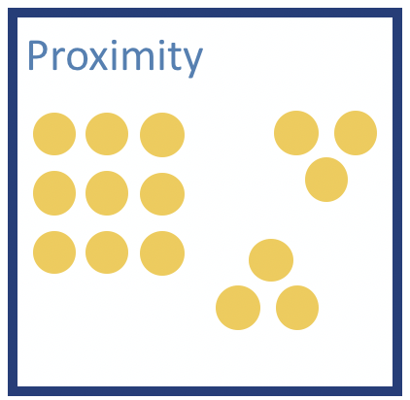
Gestalt Principles of Perception

Slide 9
PROXIMITY
our tendency to perceive objects that are physically close to each other as belonging to part of the same group

Slide 10
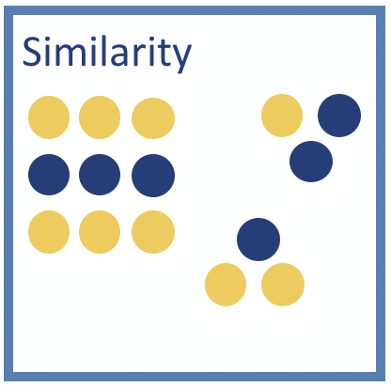

Slide 11
SIMILARITY
our tendency to perceive objects of similar color, shape, size, and/or orientation as related or belonging to part of the same group

Slide 12

CLOSURE

Slide 13
When you see an image that has missing parts, your brain will fill in the blanks and make a complete image so you can still recognize the pattern

Slide 14
CONTINUITY
our tendency to see patterns and therefore perceive things as belonging together if they form some type of continuous pattern.

Slide 15
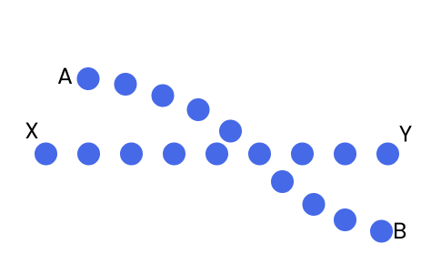

Slide 16
Figure-ground perception
Figure- refers to the object being perceived
Ground- refers to the background

Slide 17


Slide 18
Role of constancy in perception

Slide 19
Perceptual Constancy
The tendency to perceive objects as maintaining stable properties (e.g., size, shape, brightness, and color) despite differences in distance, and viewing angle

Slide 20
Size Constancy
A person’s understanding that as an object moves further or closer to them its actual size stays the same
As an object appears to become larger we realize it is getting closer, not bigger.
As an object appears to become smaller we realize it is moving farther away, not getting smaller.

Slide 21
Size Constancy
Size constancy refers to our ability to see objects as maintaining the same size even when our distance from them makes things appear larger or smaller.

Slide 22
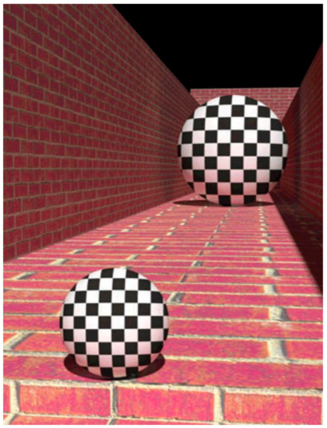

Slide 23
Shape Constancy
The understanding that an object’s shape remains the same even though the angle of view makes the shape appear changed

Slide 24
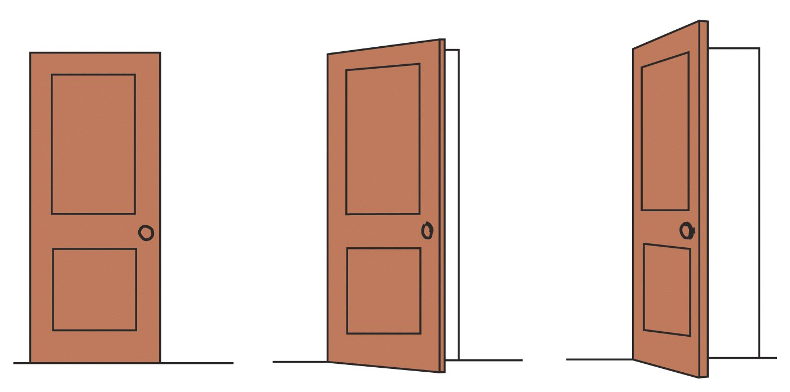
Shape Constancy

Slide 25
Illusions
Misinterpretation of the real objects
E.g. the perception of a coil of a rope in darkness as a snake
Our past experiences, our fear, and the darkness help to perceive the rope as the snake because the rope and snake have similarities in structure except living and non-living stimulus.

Slide 26
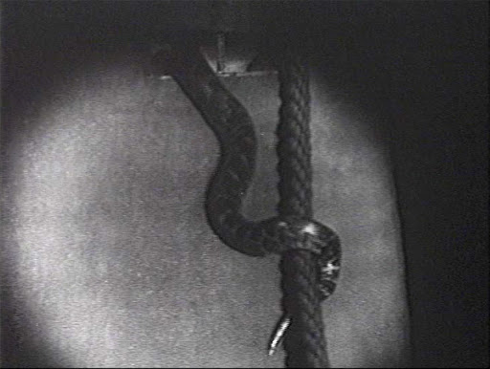

Slide 27
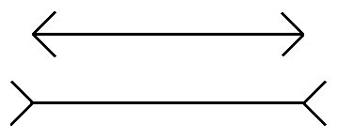
Müller-Lyer Illusion two lines of the same length are perceived to have different lengths, due to one line having arrow-heads at its ends and the other having arrow-tails.

Slide 28
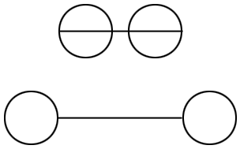
Illusion #3 Which line is longer?

Slide 29
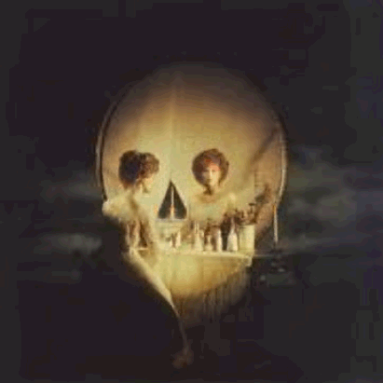
Illusion #6 Skull or woman in a mirror?

Slide 30
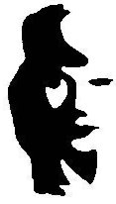
Illusion #8 Face or musician?

